Slide 1
NLP

Slide 2
Introduction to NLP
Probabilities

Slide 3
Probabilities in NLP
Very important for language processing
Example in speech recognition:
“recognize speech” vs “wreck a nice beach”
Example in machine translation:
“l’avocat general”: “the attorney general” vs. “the general avocado”
Example in information retrieval:
If a document includes three occurrences of “stir” and one of “rice”, what is the probability that it is a recipe
Probabilities make it possible to combine evidence from multiple sources in a systematic way
Notes:
CHECK EXAMPLES

Slide 4
Probabilities
Probability theory
predicting how likely it is that something will happen
Experiment (trial)
e.g., throwing a coin
Possible outcomes
heads or tails
Sample spaces
discrete (number of occurrences of “rice”) or continuous (e.g., temperature)
Events
Ω is the certain event
∅ is the impossible event
event space - all possible events

Slide 5
Sample Space
Random experiment: an experiment with uncertain outcome
e.g., flipping a coin, picking a word from text
Sample space: all possible outcomes, e.g.,
Tossing 2 fair coins, Ω ={HH, HT, TH, TT}

Slide 6
Events
Event: a subspace of the sample space
E⊆ Ω, E happens iff outcome is in E, e.g.,
E={HH} (all heads)
E={HH,TT} (same face)
Impossible event (∅)
Certain event (Ω)
Probability of Event : 0 ≤ P(E) ≤1, s.t.
P(Ω)=1 (outcome always in Ω)
P(A∪ B)=P(A)+P(B), if (A∩B)=∅ (e.g., A=same face, B=different face)

Slide 7
Example: Toss a Die
Sample space: Ω = {1,2,3,4,5,6}
Fair die:
p(1) = p(2) = p(3) = p(4) = p(5) = p(6) = 1/6
Unfair die: p(1) = 0.3, p(2) = 0.2, ...
N-dimensional die:
Ω = {1, 2, 3, 4, …, N}
Example in modeling text:
Toss a die to decide which word to write in the next position
Ω = {cat, dog, tiger, …}

Slide 8
Example: Flip a Coin
Ω : {Head, Tail}
Fair coin:
p(H) = 0.5, p(T) = 0.5
Unfair coin, e.g.:
p(H) = 0.3, p(T) = 0.7
Flipping two fair coins:
Sample space: {HH, HT, TH, TT}
Example in modeling text:
Flip a coin to decide whether or not to include a word in a document
Sample space = {appear, absence}

Slide 9
Probabilities
Probabilities
numbers between 0 and 1
Probability distribution
distributes a probability mass of 1 throughout the sample space Ω.
Example:
A fair coin is tossed three times.
What is the probability of 3 heads?
What is the probability of 2 heads?

Slide 10
Meaning of probabilities
Frequentist
I threw the coin 10 times and it turned up heads 5 times
Subjective
I am willing to bet 50 cents on heads

Slide 11
Probabilities
Joint probability: P(A∩B), also written as P(A, B)
Conditional Probability: P(B|A)=P(A∩B)/P(A)
P(A∩B) = P(A)P(B|A) = P(B)P(A|B)
So, P(A|B) = P(B|A)P(A)/P(B) (Bayes’ Rule)
For independent events, P(A∩B) = P(A)P(B), so P(A|B)=P(A)
Total probability: If A₁, …, A_{n} form a partition of S, then
P(B) = P(B∩S) = P(B, A₁) + … + P(B, A_{n}) (why?)
So, P(A_{i}|B) = P(B|A_{i})P(A_{i})/P(B) = P(B|A_{i})P(A_{i})/[P(B|A₁)P(A₁)+…+P(B|A_{n})P(A_{n})]
This allows us to compute P(A_{i}|B) based on P(B|A_{i})

Slide 12
Conditional Probability
Prior and posterior probability
Conditional probability
P(A ∩ B)
P(A|B) =
P(B)
Ω
A
B
A∩B

Slide 13
Properties of Probabilities
p(∅) = 0
P(certain event)=1
p(X) ≤ p(Y), if X ⊆ Y
p(X ∪ Y) = p(X) + p(Y), if X ∩ Y=∅

Slide 14
Conditional Probability
Six-sided fair die
P(D even)=?
P(D>=4)=?
P(D even|D>=4)=?
P(D odd|D>=4)=?
Multiple conditions
P(D odd|D>=4, D<=5)=?

Slide 15
Answers
Six-sided fair die
P(D even)=3/6=1/2
P(D>=4)=3/6=1/2
P(D even|D>=4)=2/3
P(D odd|D>=4)=1/3
Multiple conditions
P(D odd|D>=4, D<=5)=1/2

Slide 16
The Chain Rule
P(w₁,w₂,w₃…w_{n}) = ?
Using the chain rule:
P(w₁,w₂,w₃…w_{n}) =P(w₁) P(w₂|w₁) P(w₃|w₁,w₂)… P(w_{n}|w₁,w₂…w_{n-1})
This rule is used in many ways in statistical NLP, more specifically in Markov Models

Slide 17
Independence
Two events are independent when
P(A∩B) = P(A)P(B)
Unless P(B)=0 this is equivalent to saying that
P(A) = P(A|B)
If two events are not independent, they are considered dependent

Slide 18
Adding vs. Removing Constraints
Adding constraints
P(walk=yes|weather=nice)
P(walk=yes|weather=nice,freetime=yes,crowded=yes)
More accurate
But more difficult to estimate
Removing constraints (Backoff)
P(walk=yes|weather=nice,freetime=yes,crowded=yes)
P(walk=yes|weather=nice,freetime=yes)
P(walk=yes|weather=nice)
Note that it is not possible to do backoff on the left hand side of the conditional
[Example modified from Jason Eisner]

Slide 19
Random Variables
Simply a function:
The numbers are generated by a stochastic process with a certain probability distribution
Example
the discrete random variable X that is the sum of the faces of two randomly thrown fair dice
Probability mass function (pmf) which gives the probability that the random variable has different numeric values:
X: Ω → R^{n}
P(x) = P(X = x) = P(A_{x}) where A_{x} = {ω ∈ Ω : X(ω) = x}

Slide 20
Random Variables
If a random variable X is distributed according to the pmf p(x), then we write X ~ p(x)
For a discrete random variable, we have
Σp(x_{i}) = P(Ω) = 1

Slide 21
Six-sided Fair Die
p(1) = 1/6
p(2) = 1/6
etc.
P(D)=?
P(D) = {1/6, 1/6, 1/6, 1/6, 1/6, 1/6}
P(D|odd) = {1/3, 0, 1/3, 0, 1/3, 0}

Slide 22
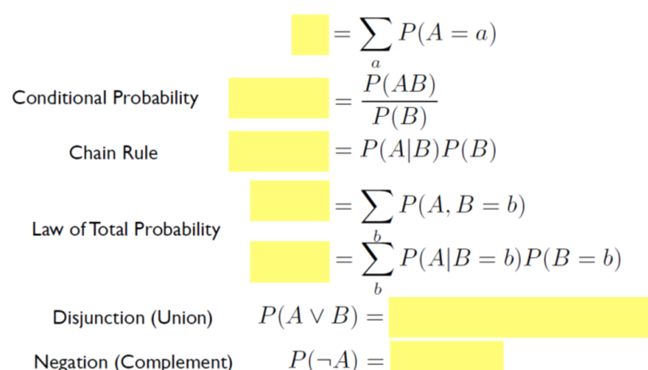
Probability Review
[slide from Brendan O’Connor]

Slide 23
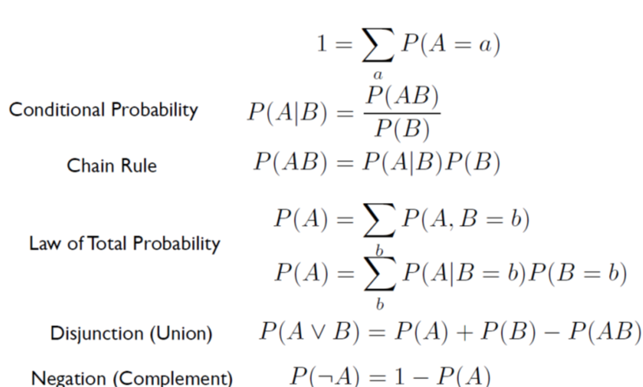
Probability Review 2/2
[slide from Brendan O’Connor]

Slide 24
NLP

